Slide 1
Tutorial-1
VHDL Intro
Part-1

Slide 2
Overview
A digital circuit can be implemented :
(1) as an application specific integrated circuit (ASIC)
(2) on a programmable device like field programmable gate array (FPGA)
In this tutorial we will discuss how a digital circuit is implemented on FPGA and which language and tool can be used to do so.

Slide 3
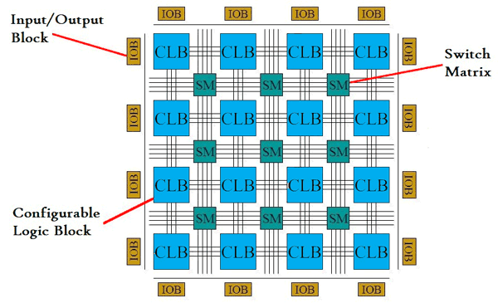
FPGA
First we need to understand what is FPGA?
FPGA: Field Programmable Gate Array

Slide 4
FPGA and CLB
A field-programmable gate array (FPGA) is an integrated circuit designed to be configured by a customer or a designer after manufacturing – hence the term field-programmable.
A configurable logic block (CLB) is the basic repeating logic resource on an FPGA. When linked together by routing resources, the components in CLBs execute complex logic functions, implement memory functions, and synchronize code on the FPGA.
CLBs contain smaller components, including flip-flops, look-up tables (LUTs), and multiplexers.

Slide 5
Popular Tools used for programming FPGA
Quartus from Intel
Xilinx ISE from Xilinx
What you have to do?
Download Quartus v20.1.1 (Lite edition) for windows or Linux operating system from the following link:
https://fpgasoftware.intel.com/20.1.1/?edition=lite&platform=windows.

Slide 6
FPGA Design Flow
Design entry using VHDL or Verilog or schematic
Behavioural simulation
Functional simulation
Synthesis
Timing simulation
Implementation
Bitstream file
FPGA programming

Slide 7
Definitions
Synthesis is used to create a netlist from HDL (e.g. VHDL or Verilog). In electronic design, a netlist is a description of the connectivity of an electronic circuit.
A bitstream is a file that contains the configuration information for an FPGA. It is also known as a bit file or programming file because by streaming it to the FPGAs configuration port, we can program the FPGA. The bitstream is a binary format, although sometimes it's stored as a human-readable hex file.
The behavioral simulation is performed at RTL-level. It is typically performed to verify code syntax, and to confirm that the code is functioning as intended.
Functional and timing simulations are performed post-synthesis or post-implementation. After synthesis or implementation, RTL is transformed to structural netlist, in which the lowest level of hierarchy consists of primitives and macro primitives.

Slide 8
VHDL : VHSIC Hardware Description Language
It looks similar as conventional programming languages, however it is different.
Important differences:
Inherently parallel
Mimics the behaviour of a physical (digital) system
Describes system as an interconnection of different components
VHSIC = Very High Speed Integrated Circuit Program

Slide 9
Basic Structure
Interface (entity declaration)
Ports
Body (Architecture)

Slide 10
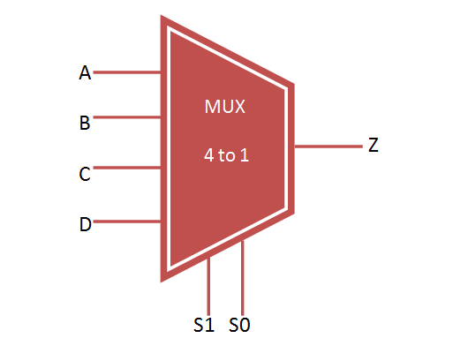
Entity Declaration
Syntax:
entity NAME_OF_ENTITY is
port (signal_names: mode type;
signal_names: mode type;
:
signal_names: mode type);
end [NAME_OF_ENTITY] ;
Example:
entity mux_4to1 is
port(
P,Q,R,S : in STD_LOGIC;
S0,S1: in STD_LOGIC;
Z: out STD_LOGIC
);
end mux_4to1;

Slide 11
Architecture body
architecture architecture_name of NAME_OF_ENTITY is
-- Declarations
-- components declarations
-- signal declarations
-- constant declarations
-- function declarations
-- procedure declarations
:
begin
-- Statements
:
end architecture_name;

Slide 12
Different models of architecture
Behavioural model
Data flow model
Structural model

Slide 13
Different models of architecture
Behavioural model
-> Describes how the output is derived from the inputs using structured statements. Behavioral modelling executes statements sequentially.
They are written inside a process statement. Statements like if-else , switch case, loops are part of behavioral modelling.
Although we never use looping statements while programming hardware as it is difficult to implement on board.
Data flow model
-> Describes how the data flows from the inputs to the output most often using NOT, AND and OR operations.
Ex: y <= a & b ;
Statements are executed concurrently.
Structural model
-> Structural modelling uses logic diagrams. The concept is similar to functions. Here we create components of each logic gate which is used multiple times in the code.

Slide 14
Behavioural model
architecture behavioral of NAME_OF_ENTITY is
begin
Process (sensitivity list)
---
---
End process;
end behavioral;

Slide 15
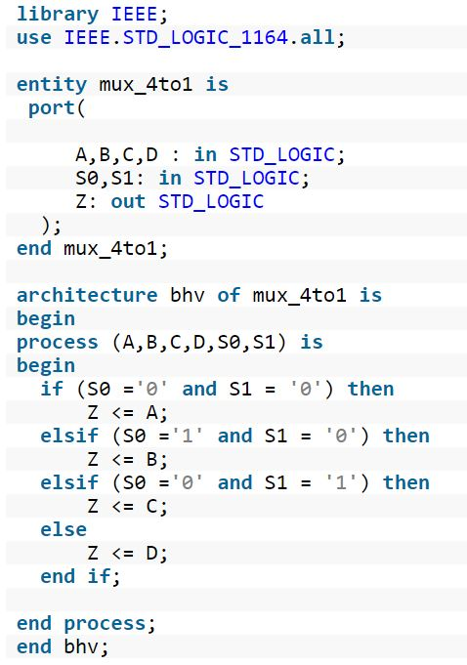
VHDL Code of 4:1 Mux
“00”
01
10
11

Slide 16
Next Tutorial
Data flow model
Structural Model

